Slide 1
Photo Tourism
With Sean & Matt

Slide 2
Tourism Types
Inward Tourism
Outward Tourism
A Single object
Photographed inward about an object
Examples
Fountains
Buildings
Architecture
Many Objects
Photographing outward around a point
Examples
Town Squares
Rooms / Halls
Panaramic

Slide 3
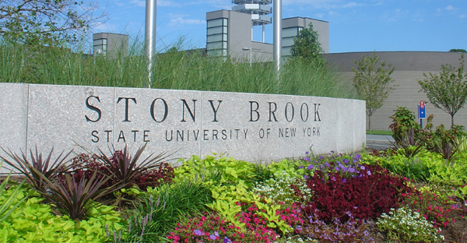
Stony Brook University

Slide 4
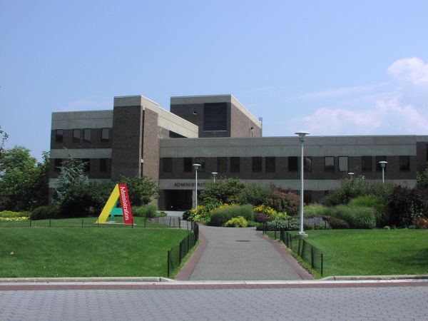
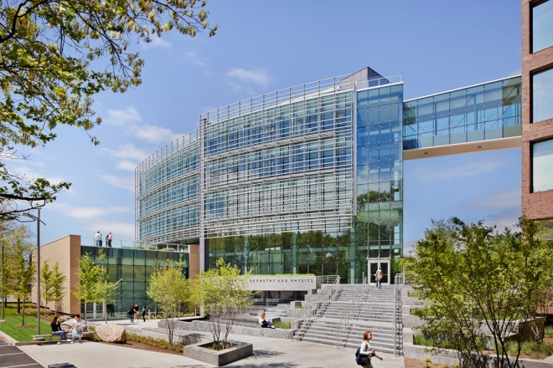
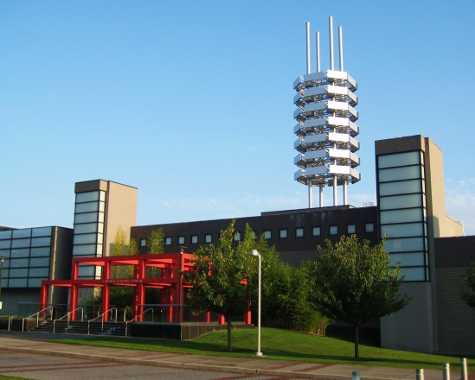
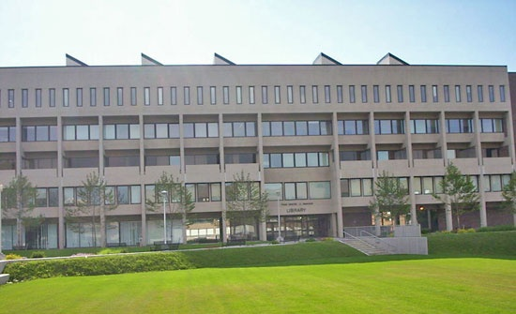
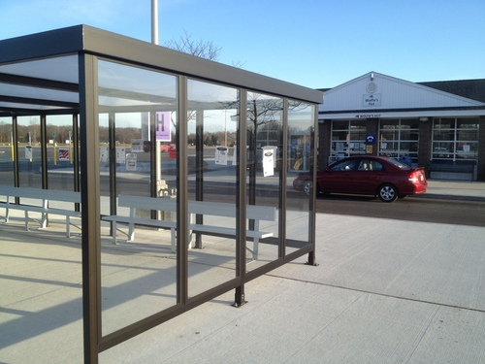
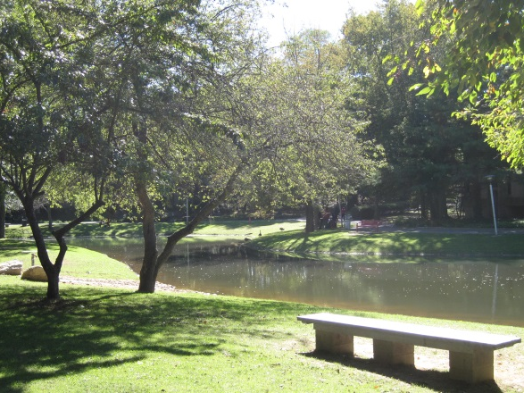
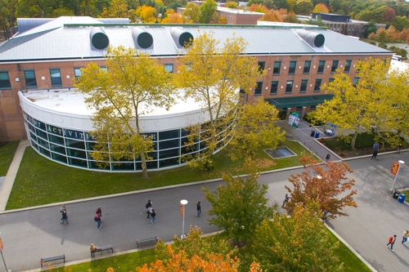
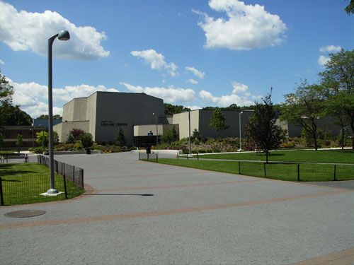
Stony Brook Virtual Tour

